Slide 1
OSCE
Skin

Slide 2
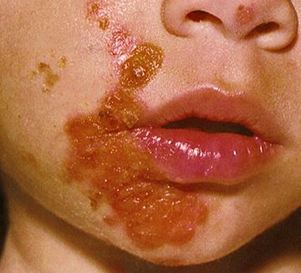
Impetigo
is a contagious superficial bacterial infection of skin
Classified as
Primary :-direct bacterial invasion of previously normal skin and
Secondary:-infection at sites of minor skin trauma

Slide 3
Common in 3-5 year olds
Most common cause is Strept and S.Aureus
R/F-poverty, crowding, poor hygiene, and underlying scabies
Variants are Non-bullous, Bullous, and Ecthyma.
MX-Topical therapy with mupirocin 2%, fusidic acid, and retapamulin 1% and systemic therapy with oral antibiotics.

Slide 4
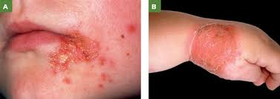
Impetigo Pictures

Slide 5
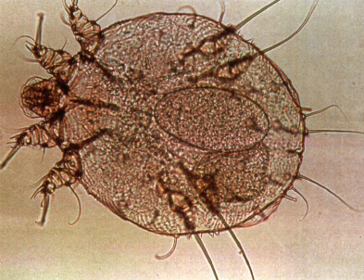
Scabies
Sarcoptes scabiei, the itch mite, is an oval, ventrally flattened mite with dorsal spines
Itchiness is the most obvious symptom of scabies
It is worse at night time when patient is warm
The pathognomonic sign of scabies is a burrows appear as slightly elevated, grayish, tortuous lines in the skin.

Slide 6
Typical sites involvement (in adults):
  interdigital webbing of the hands,
  flexural aspect of the wrists, behind the ears, axilla, waist, ankles, feet, buttocks & belt area
  penile & scrotal in men, areola, nipples & genital area in women
  The circle of Hebra - an imaginary circle intersecting the main sites of invt – nipple, axillae, elbow flexures, wrists & hands, & crotch/groin
  In infants, elderly & immunocompromised hosts, all skin surfaces are susceptible, including the scalp & face

Slide 7
Variants include nodular, bullous and norwegian/ hyperkeratotic/crusted

Slide 8
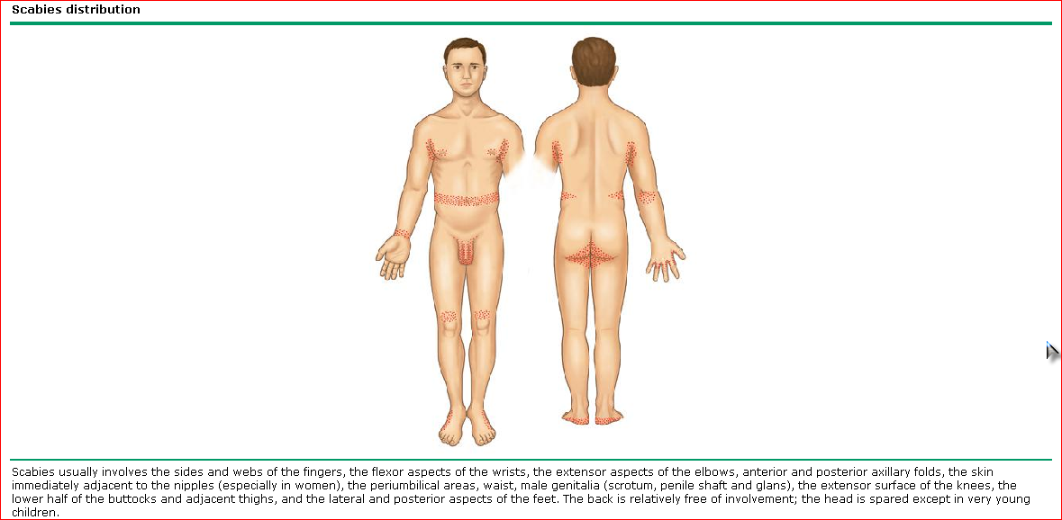

Slide 9
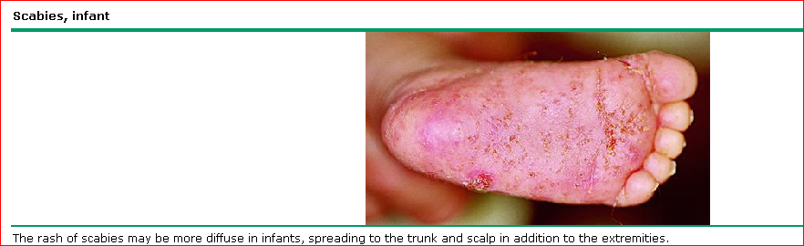

Slide 10
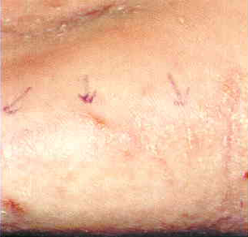
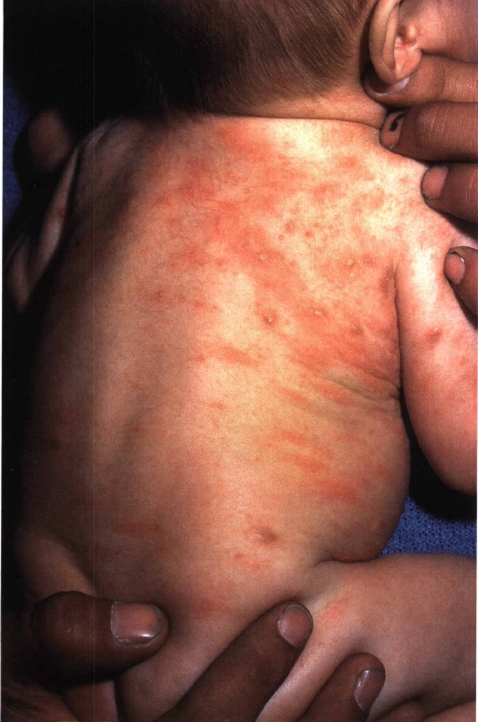
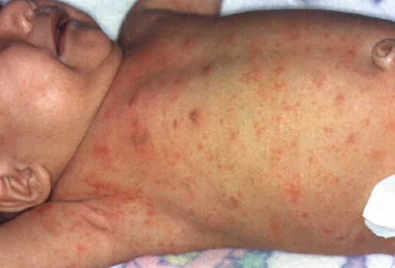

Slide 11
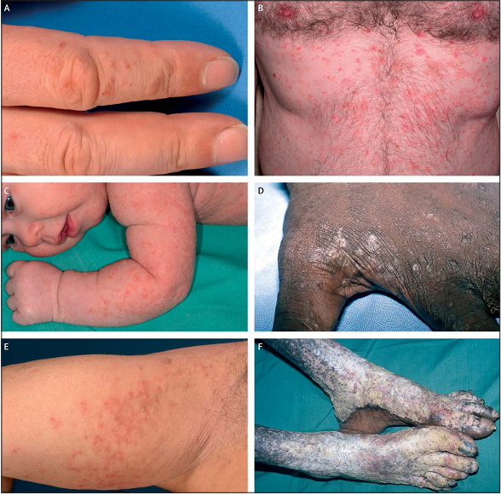

Slide 12
IX and MX of scabies
Diagnosis
Mainly clinical
  Pruritus with typical lesions & distribution
  Pruritus in household members or close personal contacts
  Microscope
  Scrap an unscratched burrow----→ cover with a drop of immersion oil, ------→ scrap with a No.15 blade or dermal curette & placed on a glass slide with a coverslip-------→ Under the 10x objective of the microscope, the female mite and/or her eggs or feces are seen
    skin scrapings obtained from the finger webs, wrists, or ankles is most likely to be positive
    In Norwegian scabies, scraping of the thick scales will often yield several viable mites
    Excoriated lesions are often negative

Slide 13
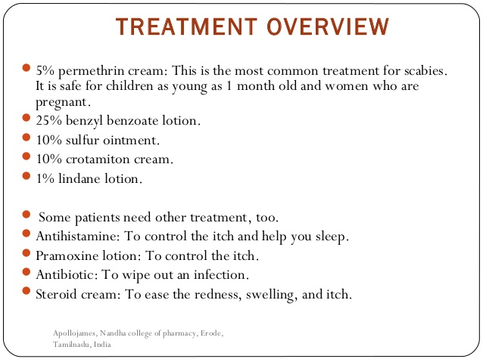
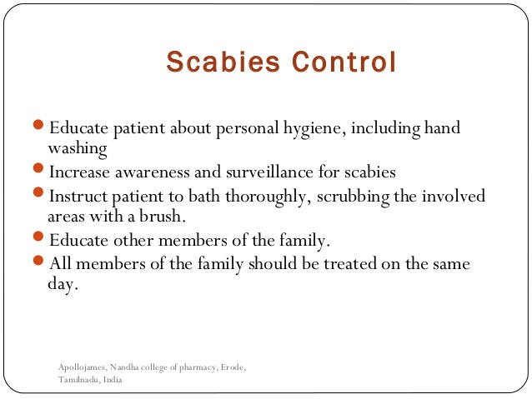
Management of scabies mainly ivermectin and permethrin

Slide 14
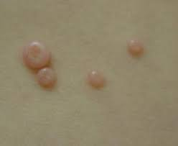
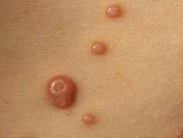
Molluscum Contagiousum
Several fleshy lesions with ambilicated centers on the face. They tend to regress and disappears after some months.

Slide 15
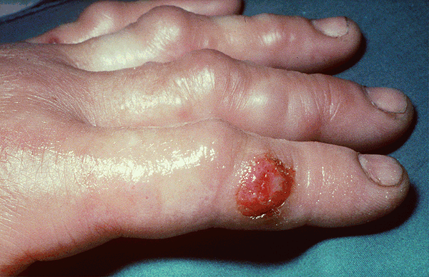
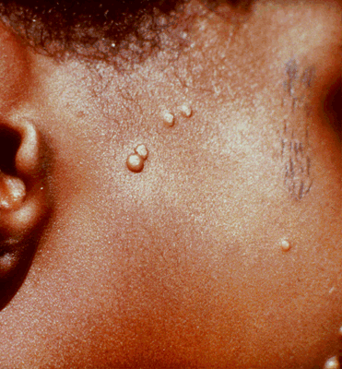
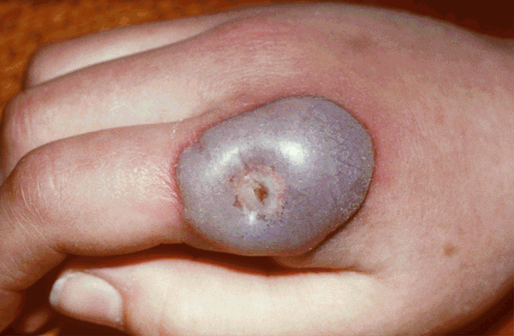

Slide 16
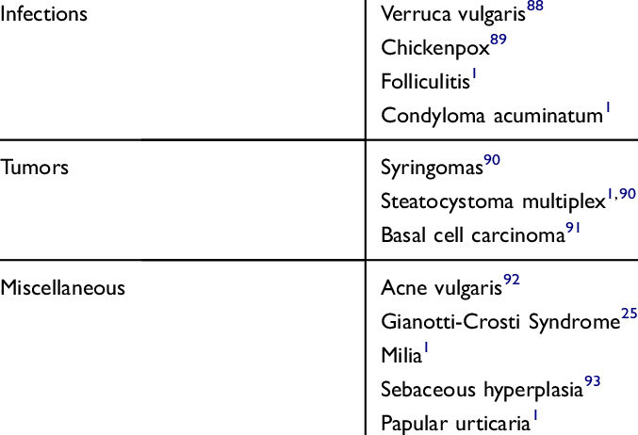
Molluscum DDX

Slide 17
Molluscum contagiosum is a benign disease caused by the poxvirus family and spread by close human contact.
The lesions are characteristic firm white nodules which vary greatly in number and tend to persist for a period of a few weeks to a few months.
Sometimes they may be found in clusters along a scar

Slide 18
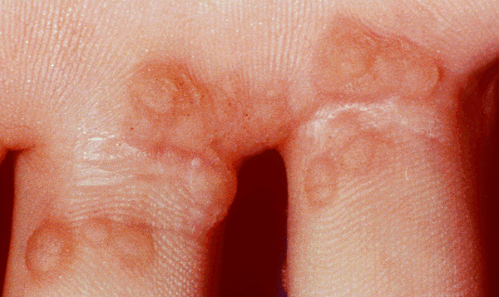
Wart
Most common warts are 2-10mm in diameter (although they may coalesce to larger masses), flesh-coloured or brown, keratotic papules with a rough surface.

Slide 19
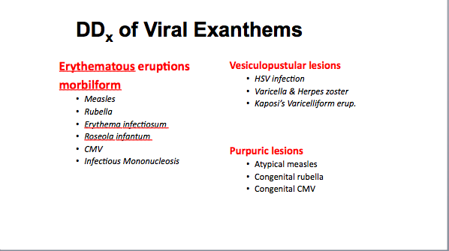
Very important

Slide 20
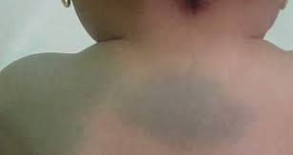
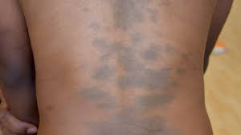
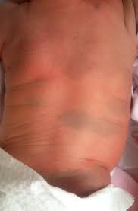
Mongolian spot

Slide 21
Blue- grey poorly circumscribed, mutliple or single maculae found most commonly on the lumbosacral region

